Slide 1
Rover Navigation Project
Tori Jackson
Seed used for presentation: 152673

Slide 2
Background
A Rover has landed on the planet Reach, searching a new habitable planet for humans. The team behind it has located interesting landmarks from space, and has tasked the Rover to get there as quickly as possible:
Valles Zeta – Bio-signature detection zone
Olympus Langrenus – Unusual rock formation with trace elements
Crater Tycho – Site of geological anomaly
Valles Gamma – Unusual rock formation with trace elements
Sea of Theta – Unusual rock formation with trace elements

Slide 3
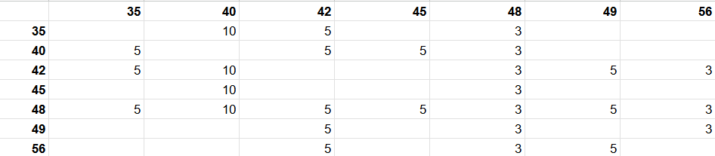
Mapping with Adjacency Matrix
Main Index: (x+1)*(y+1), move up if full
Connection tracker: the cost of distance between the nodes (assuming start = 0)
Pros:
Can easily obtain the cost of each node
Cons:
Will leave a lot of blanks for impassable nodes, as well as nodes that don’t connect to each other
Ex: Connections of (8,6), Index 48
(Indexes between missing for size)

Slide 4
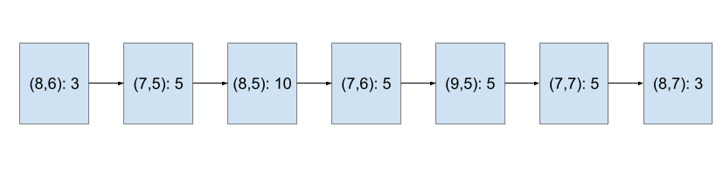
Mapping with Indices List
Ex: Connections of (8,6), Index 48
Main Index: (x+1)*(y+1), move up if full
Connection tracker: vector of connections with cost
Pros:
Saves memory by avoiding any non-connecting nodes
Cons:
Can only get one connection at a time (but this is bypassed by the algorithms iterating between each node)

Slide 5
How it Works: Dijkstra's Algorithm
The function takes 2 parameters: a start node and the planet graph
Before the actual looping begins, DjkstraResult’s hashmaps are initialized: all node’s costs are equal to infinity(or a maximum number) and their previous nodes are equal to nullptr, that way they can be updated later.
From there, the start node’s distance in initialized to 0, and a min heap is created to pop out the node with the smallest cost. From there, the start node is pushed.

Slide 6
How it Works: Dijkstra's Algorithm
While the heap isn’t empty:
Get the current node and it’s distance before popping it
Each node has a vector of it’s edge connection, so for each one:
Get the destination node and it’s distance (and add the current distance to it)
If that distance is less that the given distance in the hashmap:
Change the hashmap cost, set the current as the previous node, and push in the new value and the node to the heap.
If not, continue on. The heap will run out eventually.
From there, the DijkstraResult will create a vector with all the nodes starting from the end, using the previous pointers, then it will reverse and be returned to the program.

Slide 7
How it Works: Uniform Cost Search
The search works similarly to Dijkstra's Algorithm, but since there’s no access to the full graph, the distance and previous hashmaps are created in the function, with and additional vector to track whether nodes have already been visited. The parameters taken are the start node and the target node.

Slide 8
How it Works: Uniform Cost Search
While the heap isn’t empty:
Get the current node and it’s distance before popping it
If the current node is the target, break the loop
For each edge:
Get the destination node, and it’s distance plus the current distance, and a check if the node has been visited yet.
If that distance is less that the given distance in the hashmap or it hasn’t been visited yet:
Change the hashmap cost, set the current as the previous node, add the node to the visited vector, and push in the new value and the node to the heap.
When the target is found, a vector is created, connecting the route

Slide 9
Full Route Itinerary
The Rover will head west, and go over a mix of rocky and sandy terrain, before heading into the mountains to reach Valles Zeta
From there, the Rover will descend from the mountain, back down to rocks and sand. It will continue south until it reaches another set of mountains before reaching Olympus Langrenus, within a crater.
The Rover will head north, past the craters and mountains, moving on rocks and sand. It will pass the Sea of Theta it arrives at Crater Tycho
The Rover will head south and avoid the mountains before it reaches Valles Gamma
The Rover will head northwest before going down, avoiding mountains again as it ends its journey at the Sea of Theta

